Slide 1

AI Engineer Case Study
Jacobo Fernandez Vargas

Slide 2
Index
Problem description
Initial analysis
Algorithms
Fitness function
Data engineering

Slide 3

Problem to solve
Shortest path between two points:
Shortest not necessarily based on distance
Multiple objective optimization
Multiple constrains
Theoretically not NP problem → Optimal solution may be possible
Amount of data too large to find optimal solution
Not well-defined fitness function

Slide 4

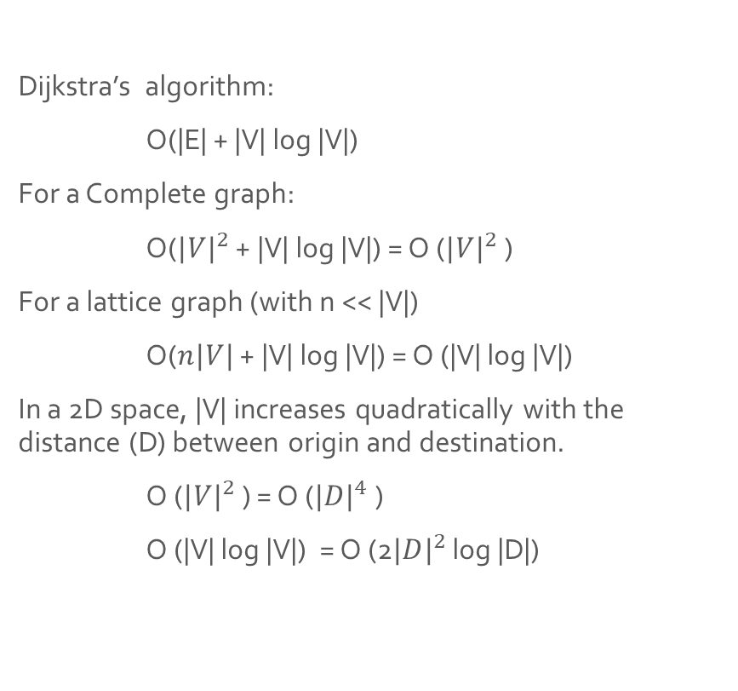
Algorithm Complexity
Dijkstra’s algorithm:
O(|E| + |V| log |V|)
For a Complete graph:
O(${|V|}^{2}$ + |V| log |V|) = O (${|V|}^{2}$ )
For a lattice graph (with n << |V|)
O($n|V|$ + |V| log |V|) = O (|V| log |V|)
In a 2D space, |V| increases quadratically with the distance (D) between origin and destination.
O (${|V|}^{2}$ ) = O (${|D|}^{4}$ )
O (|V| log |V|) = O (2${|D|}^{2}$ log |D|)

Slide 5

Literature review
[I’m not an expert in the field and the review was limited]
The problem has been extensively researched
Solutions are heuristic based
No ‘best’ approach, or even range of approaches

Slide 6

Data structure
Graph:
Nodes: Geographical points, with position and constrains information (e.g. conservation area, flooding probability etc.)
Edges: Non directed connections between ‘close’ nodes (not fully connected).
Edge weight: Function based on node information and path (e.g. turns)

Slide 7

Implementation consideration
We want to have a single fitness function, no multi-objective
Create set of weights for different constrains → Expert knowledge required
We want multiple solutions → Multiple initializations / weights
Most of the algorithms have stochasticity elements → we want to be able to parallelize

Slide 8
Model selection
I propose to, initially, select two algorithms to solve the problem as different as possible.
Out of the plethora of alternatives, I selected Genetic Algorithms (GA), and Ant Colony Optimization (ACO)
Commonly used to solve the problem
Both are highly parallelizable
Very different approach
[I have previous knowledge about them]

Slide 9
GA vs ACO
 | GA | ACO
Step | Full path | Single edge
Result | Populations (+/- similar) | Probability
Local minimum | Prevented with 'islands' | Not a problem
Computation cost | Lower | Higher
Multi objective | Ok | Needs to be at edge level
On the fly graph change | Harder | Easier
Scalability | Better | Worse
Implementation difficulty | Harder | Easier

Slide 10
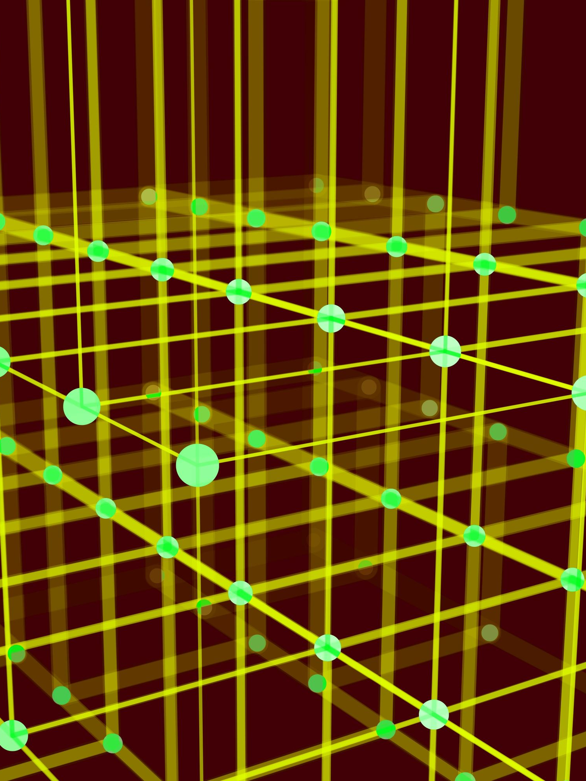
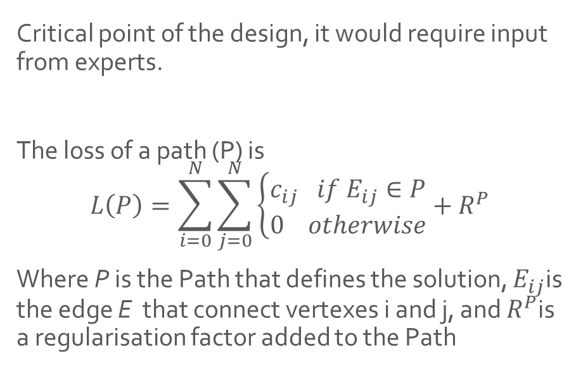
Loss function
Critical point of the design, it would require input from experts.
The loss of a path (P) is
$$L\left(P\right)=\sum_{i=0}^{N}{\sum_{j=0}^{N}{\left\{\begin{aligned}c_{ij} if E_{ij}∈P \\ 0 otherwise\end{aligned}\right.}}+R^{P}$$
Where P is the Path that defines the solution, $E_{ij}$is the edge E that connect vertexes i and j, and $R^{P}$is a regularisation factor added to the Path

Slide 11

Edge cost function
The edge cost between two nodes (i, j) will be:
$$c_{ij}=dist\left(i,j\right)∗(1+\sum_{m=0}^{M}{w_{m}\left(i,j\right))+R^{E_{ij}}}$$
Where $dist$ is the Euclidean Distance, $m$ are the different cost modifiers that are obtained from a table, and $R^{E_{ij}}$is a regularisation factor
Slope | 0% | 5% | 10% | 20% | 30%
w | 0 | 0.1 | 0.15 | 0.3 | 0.5
Park | None | Green Inf. | National
w | 0 | 0.1 | 1
Woodlands | No | Crop | Seminatural | Ancient
w | 0 | 0.01 | 0.1 | 2

Slide 12


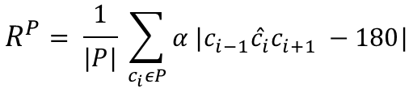
Regularisation
$R^{E_{ij}}$represents things like crossing infrastructures
$R^{P}$represents things related to the specific Path, e.g. how straight it is
Type | R
Motorway | 100
A road | 50
B road | 20
Railway | 150
Pipelines | 15
Transmission | 10
$$R^{P}= \frac{1}{|P|} \sum_{c_{i}εP}{α |c_{i−1}{\hat{c}}_{i}c_{i+1} −180|}$$

Slide 13
Data Engineering
Create Lattice
Dynamic granularity
A
B
A
B

Slide 14
Data Engineering
Bottleneck / bridge identification
B
A
B
C
A
C
B'
Bi-directional heuristic
A
B
A
B

